Slide 1
Tips on How to Read Drug Reports
Vermont Forensic Laboratory
January 2021

Slide 2
Outline
General Information
Item Numbering
Reading the Results
Who to Contact

Slide 3
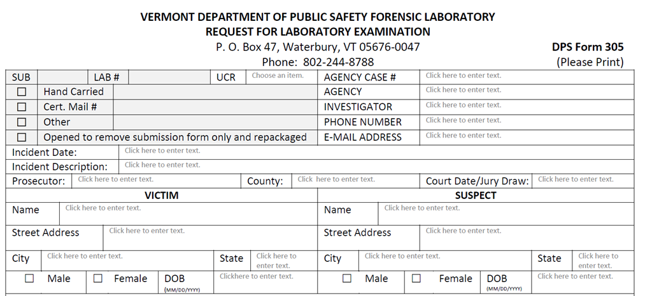
General Information

Slide 4
305 Info From Agency
Case Number
Agency’s Address
Investigating Officer
Suspect’s Name
UCR Code/Offense
Attorney

Slide 5
VFL Case Number & Exam Type
The VFL assigned case number given upon submission which serves as the report’s unique identifier with the exam type(s) requested below
Formatted V00-000-1
Vermont lab
Year
Sequential by case submission
Ex: 100, 101,102
Report Number

Slide 6
Date Completed
The date the report was completed
*Due to the review process for all cases, there may be a time gap between this date and the date it is received by the customer.

Slide 7
Understanding the Item numbering system

Slide 8
Item Numbering: Part 1
Item numbering is done sequentially in a nesting format
Example #1: Item A1-1-3
A refers to the submission
(A=1st, B=2nd, C=3rd, etc)
1 refers to the outermost evidence container
A1 = 1st container 1st submission
1 refers to an item found directly inside of the evidence container A1
3 refers to a sub-item of A1-1

Slide 9
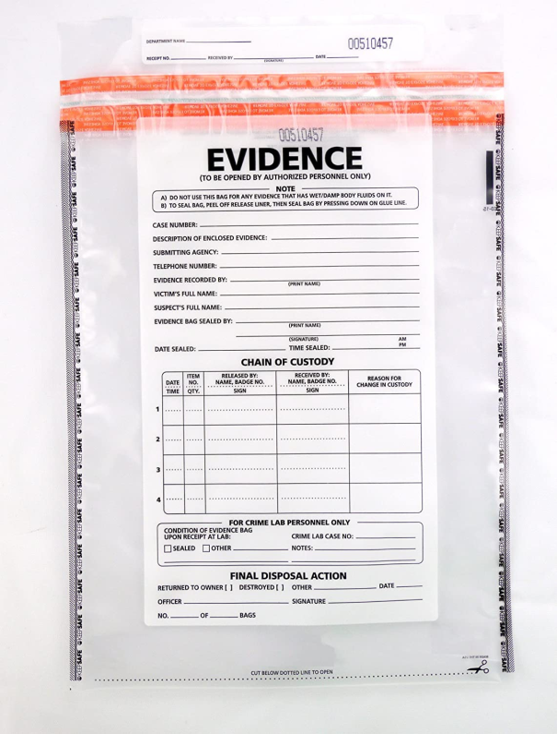
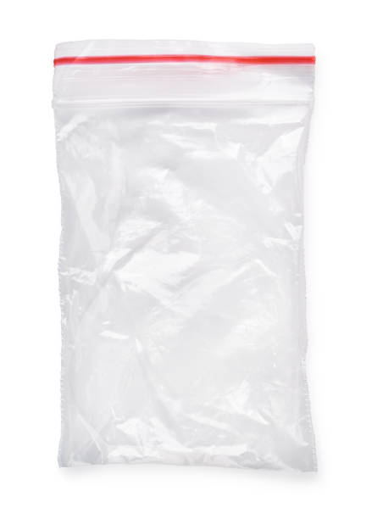
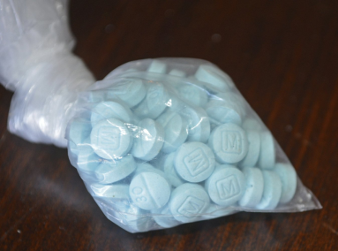
Example #2 – Give it a try
Example #2: Item
C2
-1
-1 and 2
Sub-Item 1/2 from Item 1 of the 2nd container from the 3rd submission
Item C2-1-1
Item C2-1
Item C2-1-2
Container: C2

Slide 10
Item Numbering: Part 2
In this example, there were 5 items created from directly inside of the evidence container A1
Descriptions of each item are found next to the item’s number
Items 1-5

Slide 11
Reading the Results

Slide 12
Conclusive Results: Part 1
If a substance has been confirmed to be present in an item it will state:
“was found to contain”

Slide 13
Conclusive Results: Part 2
After “found to contain”, all confirmed substances are listed in order of their greatest to least quantities present in that sample
Example: Item A1-2 fentanyl > heroin > cocaine

Slide 14
Not Analyzed Results
If an item was physically analyzed or weighed, but no chemical analysis was completed it will state:
“was not chemically analyzed”
If an item was not examined at all and no weight was taken it will state:
“was not examined”

Slide 15
Preliminary Results
If an item has any substances that have preliminarily been found it will state:
“was preliminarily found to contain”
This means that we have reason to believe that substance is present, but the tests ran did not reach all of the criteria to confirm it.

Slide 16
Other Results
If no regulated substances were detected it will state:
“was found to contain no regulated substances”

Slide 17
Weights
All weights are net weights of just the sample without the packaging
unless otherwise stated like Item A1-5
If the weight is less than 10 mg, an exact weight is not reported as in Item A1-2

Slide 18
Who to call

Slide 19
Who To Contact
The scientist who completed the examination is listed at the bottom

Slide 20
Who To Contact
The laboratory’s main contact information is also included and we can help you get in contact with the right person

Slide 21
Additional Contacts
Denise Gregory
Drug Chemistry Supervisor
Denise.Gregory@vermont.gov
Trisha Conti, Ph.D.
Lab Director
Trisha.Conti@vermont.gov
DPS.VFLLabReports@vermont.gov
Feel free to reach out with any questions.
Any questions sent to DPS.VFLLabReports@vermont.gov can be directed to the appropriate contact.

Slide 22
Summary
Where to Find General Info
Item Numbering System
How to Read the Results
How to Reach Us

Slide 23
Thank you!
Questions?

